Slide 1
The visual interpretation of decision trees
(How to lead a fulfilling life by being dissatisfied)
Terence Parr University of San Francisco
Work done with Prince Grover
manifold.ai

Slide 2
Topics
dtreeviz 0.3: Visualizing training of regression, classification trees
dtreeviz 0.2: Visualizing key elements of decision trees
Implementation notes
How to lead a fulfilling life by being dissatisfied

Slide 3
Training Decision trees

Slide 4
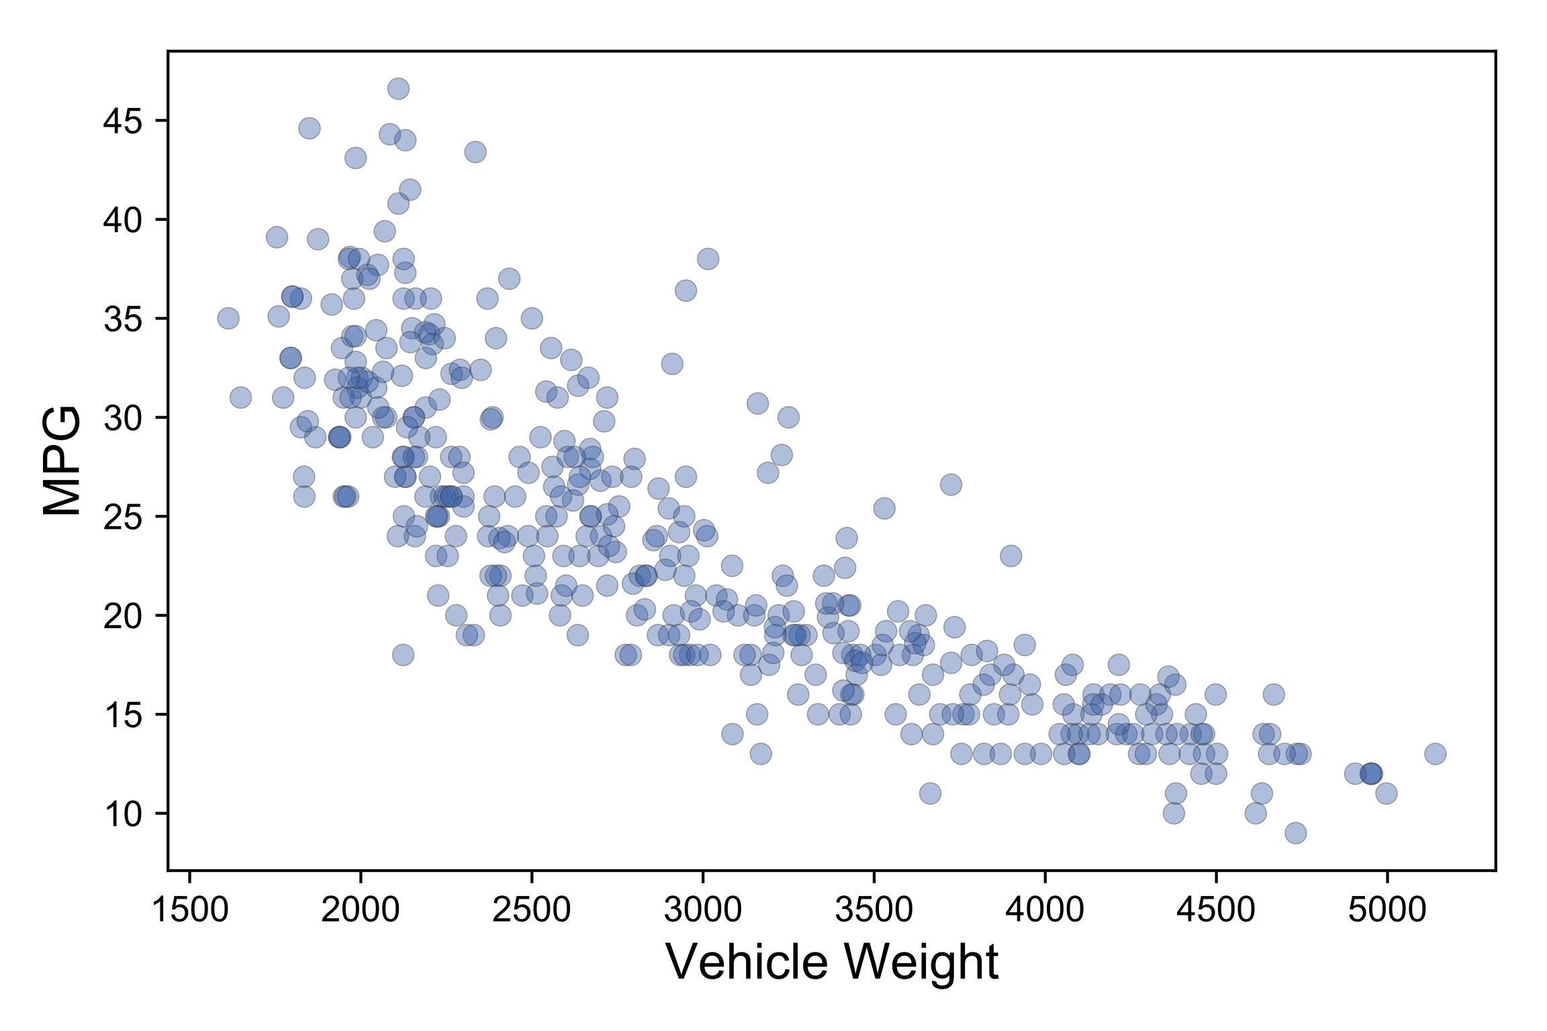
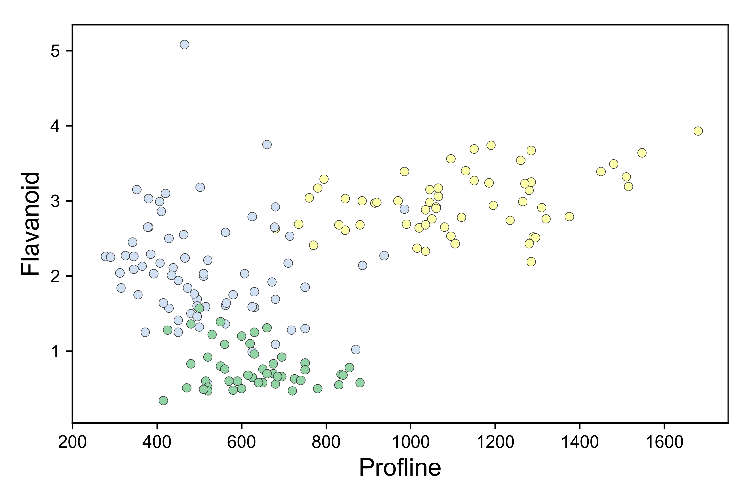
Regression versus classification
Regressors draw through data
Classifiers draw between data clusters

Slide 5
Different models have different surfaces

Slide 6
Model is just the decision surface(s)

Slide 7
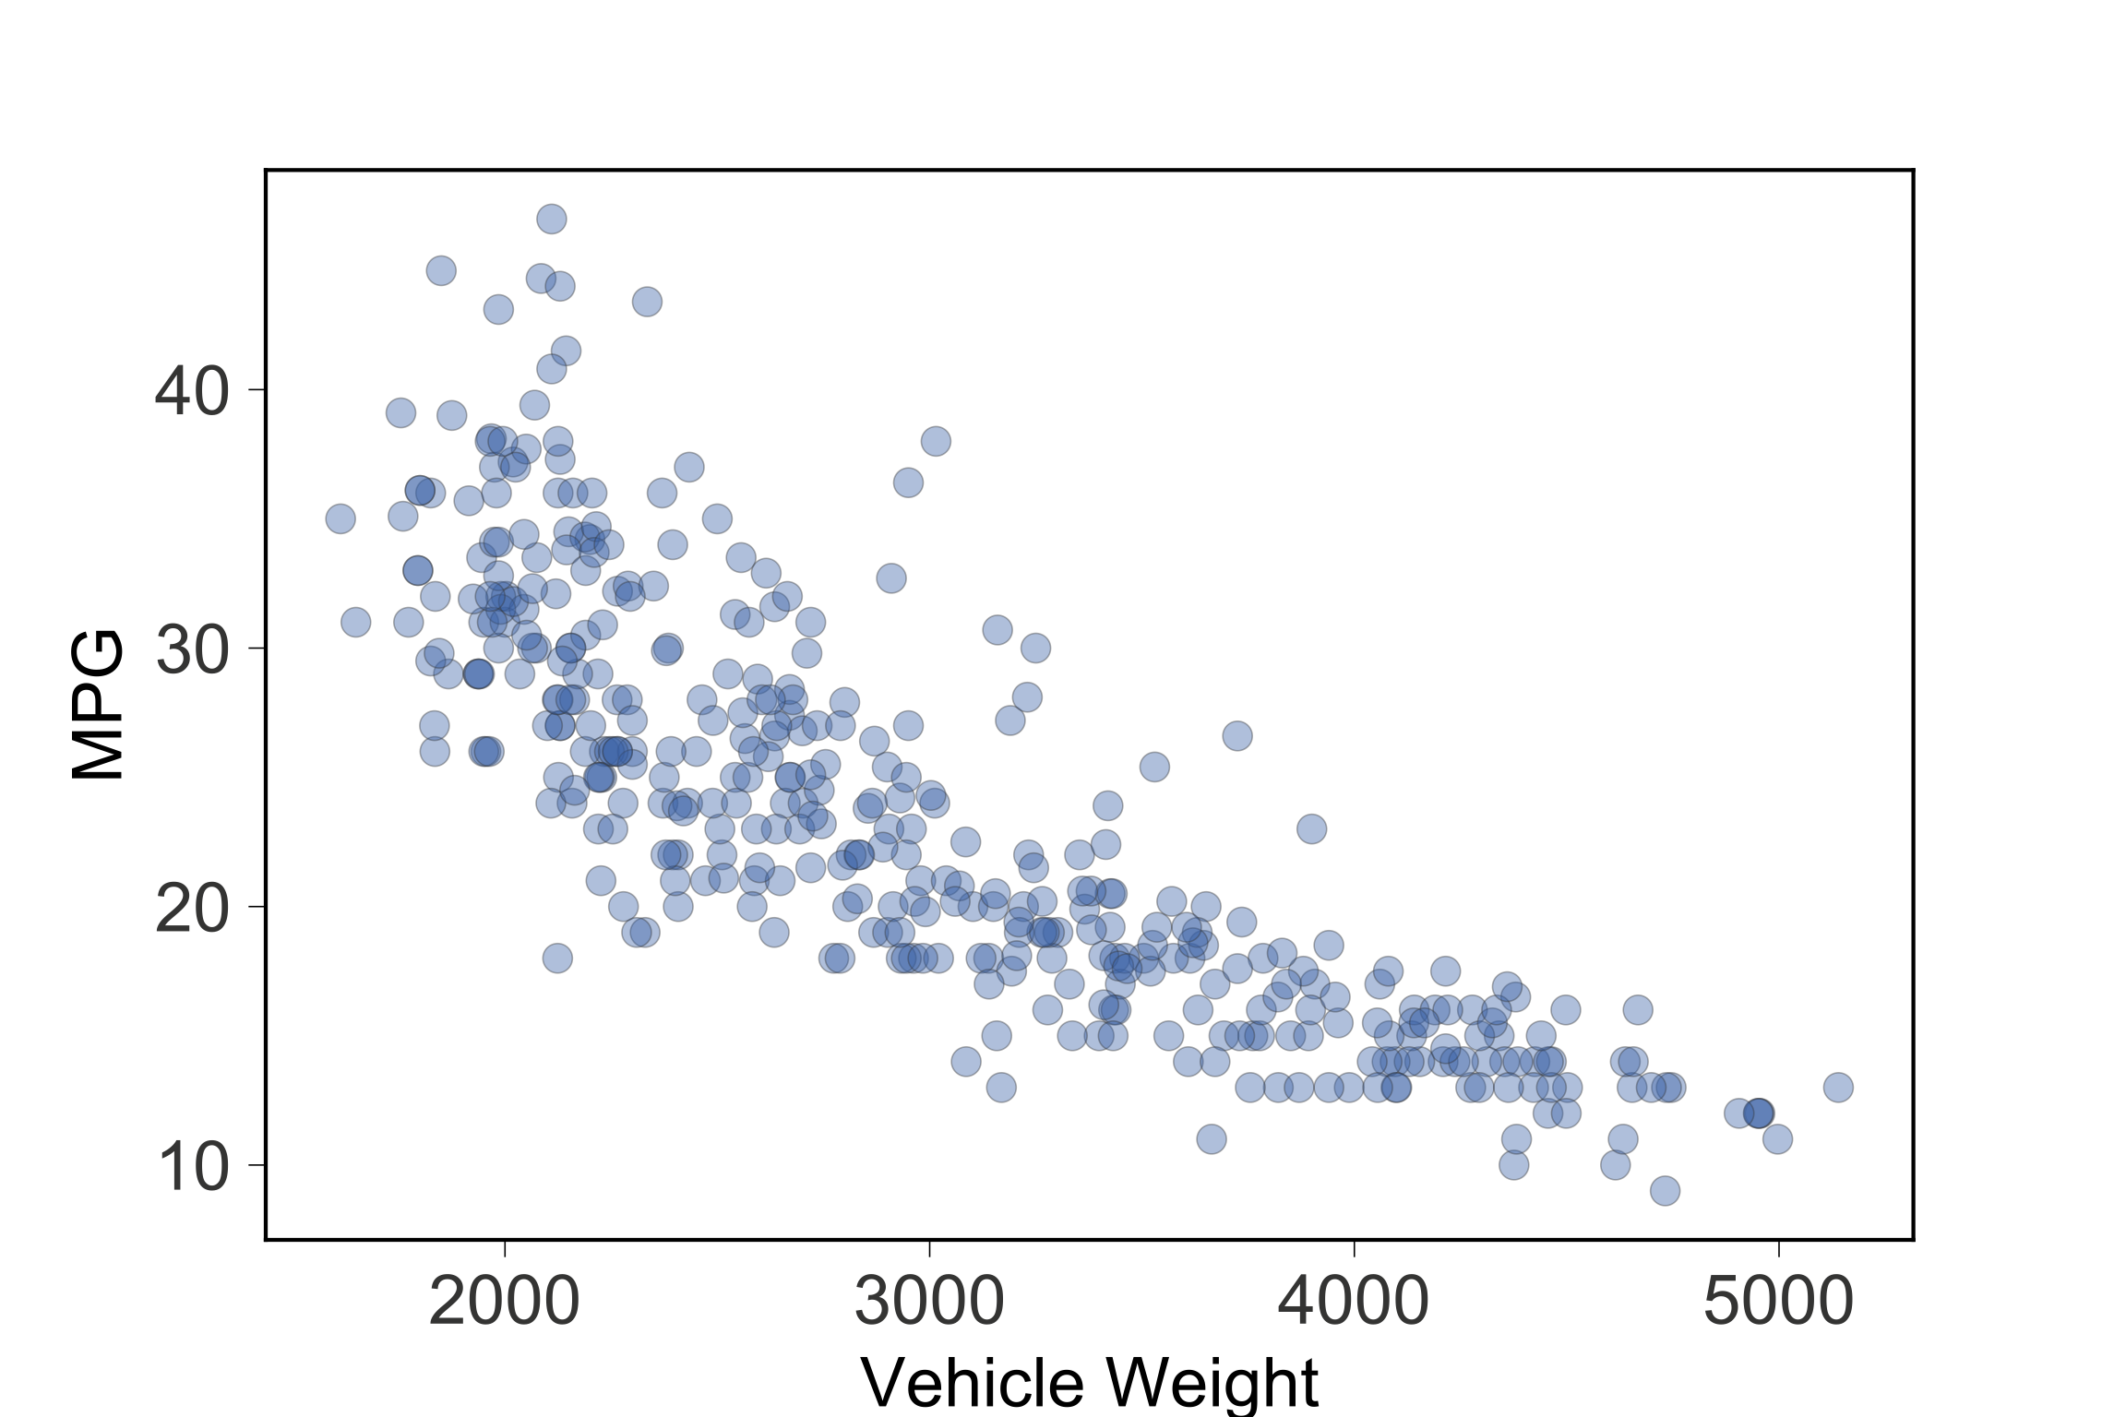
Let’s invent a simple regressor
Predict MPG
from weight
Predict a single
constant for
entire region
(the mean)
MSE is high
Residuals from
point to region
mean

Slide 8
Improve by partitioning, using multiple lines
WHERE DO
WE SPLIT??
Can only use
horizontal lines,
but can use lots
Each region
predicts mean
in piecewise
fashion
Find groups
of similar MPG
values, which
yields a lower
MSE

Slide 9
Strategy: find split point giving least MSE
Split region
into two
subregions,
each
predicting
mean
X=2000 is
BAD CHOICE:
MSE very high
BOO!

Slide 10
Strategy: find split point giving least MSE
Split region
into two
subregions,
each
predicting
mean
X=3500 is
ANOTHER
BAD CHOICE:
MSE very high
BOO!

Slide 11
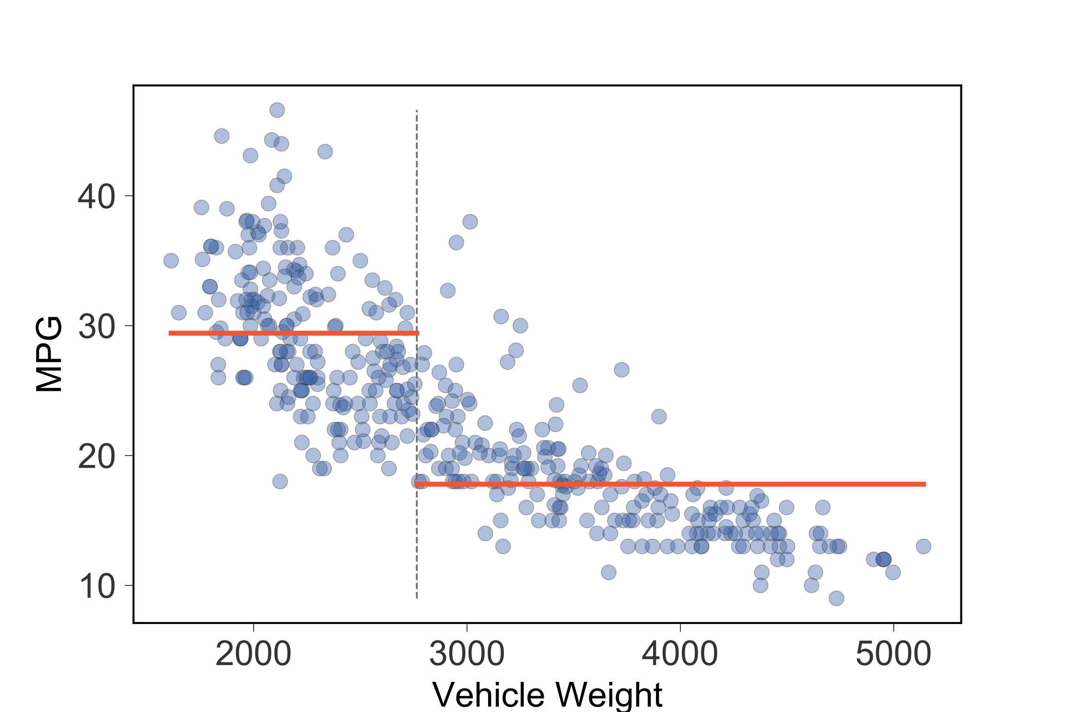
A split exists that gives min MSE for regions
Technique: Exhaustively
check all feature
values, computing MSE for each split
Track split point
giving min MSE
WOOT!
s1

Slide 12
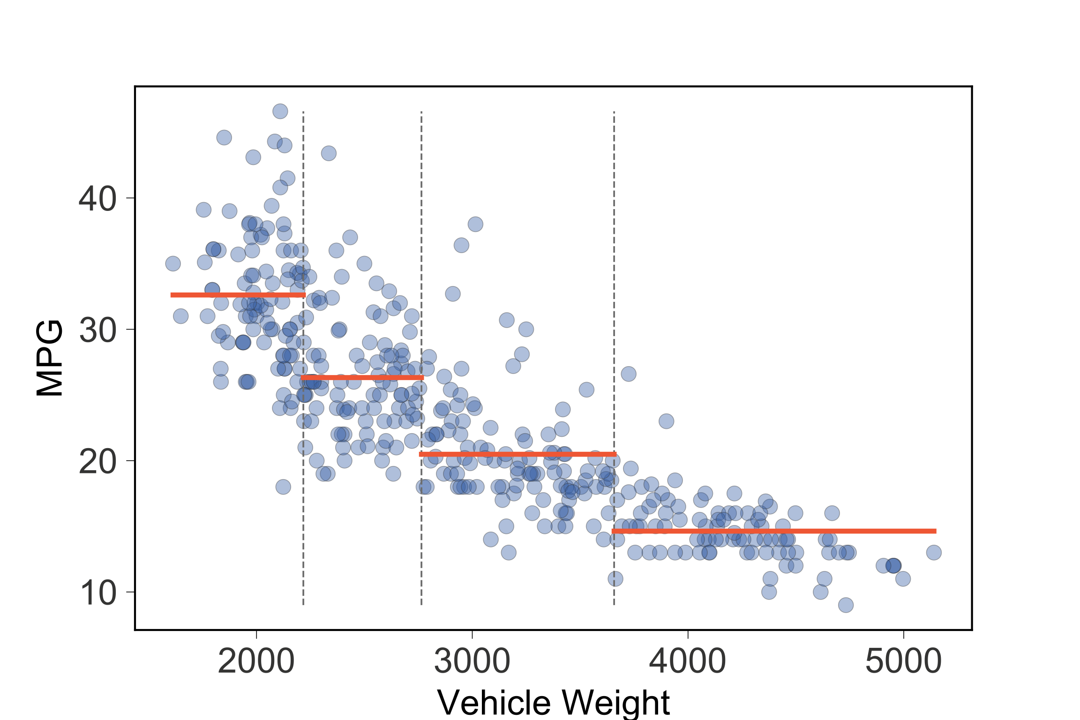
Now split those 2 regions into 4 regions
Split s1 stays,
recursively split
left/right regions to
get splits s2, s3
Kinda like binary
search or other
divide-and-conquer
strategy
s2
s1
s3

Slide 13
Model training recursion tree gives regions defined by splits s1,s2,s3
s1=split(1000,5000)
s2=split(1000,s1)
s3=split(s1,5000)
s2
s1
s3
[1000,s2)
[s2,s1)
[s1,s3)
[s3,5000)
Split (recurse) until:
All potential splits do not reduce MSE
Acceptable MSE achieved
Max number of splits reached
Etc…
Predictions are avg of MPG
(target) values in regions

Slide 14
Hardcoded model implementation
To partition space: test in split order
if x<s1 and x<s2: predict 32.6
if x<s1 and x>=s2: predict 26.3
if x>=s1 and x<s3: predict 20.5
if x>=s1 and x>=s3: predict 14.6
Note repeated comparisons!
s2
s1
s3

Slide 15
Factor the split comparisons for efficiency
if x<s1:
if x<s2: predict 32.6
else: predict 26.3
else:
if x<s3: predict 20.5
else: predict 14.6
s2
s1
s3
But, don’t want to hardcode model!

Slide 16
Represent nested conditionals as regression decision tree
s1
<
>=
s2
s3
<
>=
<
>=
32.6
26.3
20.5
14.6
s2
s1
s3
Internal nodes test features
Leaves predict region mean
Recursion tree from training becomes decision tree!

Slide 17
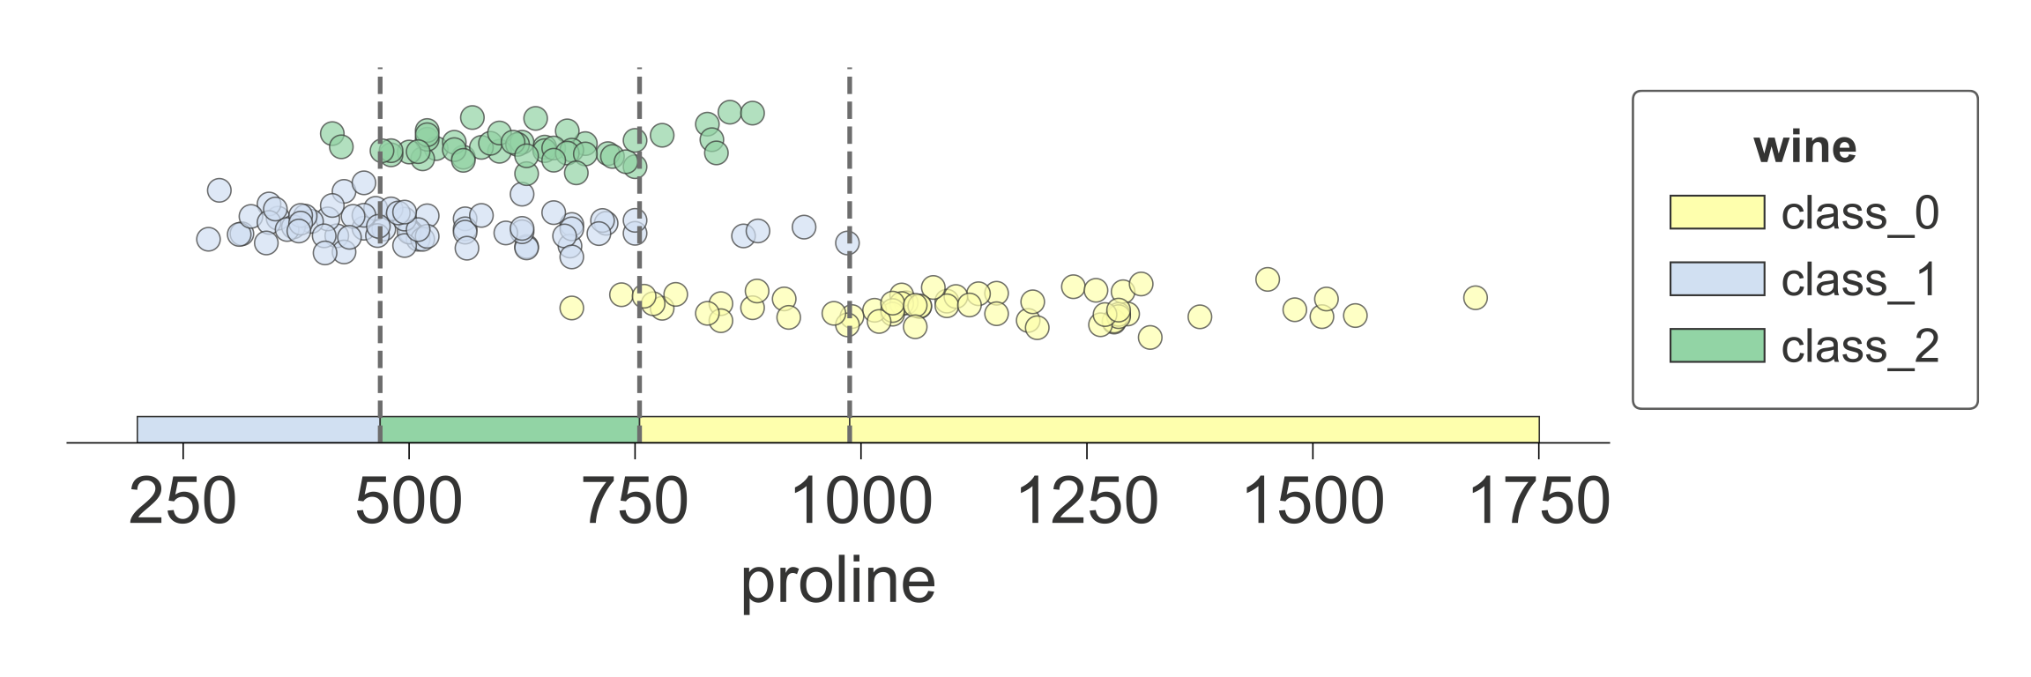
Classifiers split feature space too
Predict wine
from proline
s2
s1
s3
s1
<
>=
s2
s3
<
>=
<
>=
Internal decision nodes test features just like regressor trees
Leaves predict most common target category (mode) not mean

Slide 18
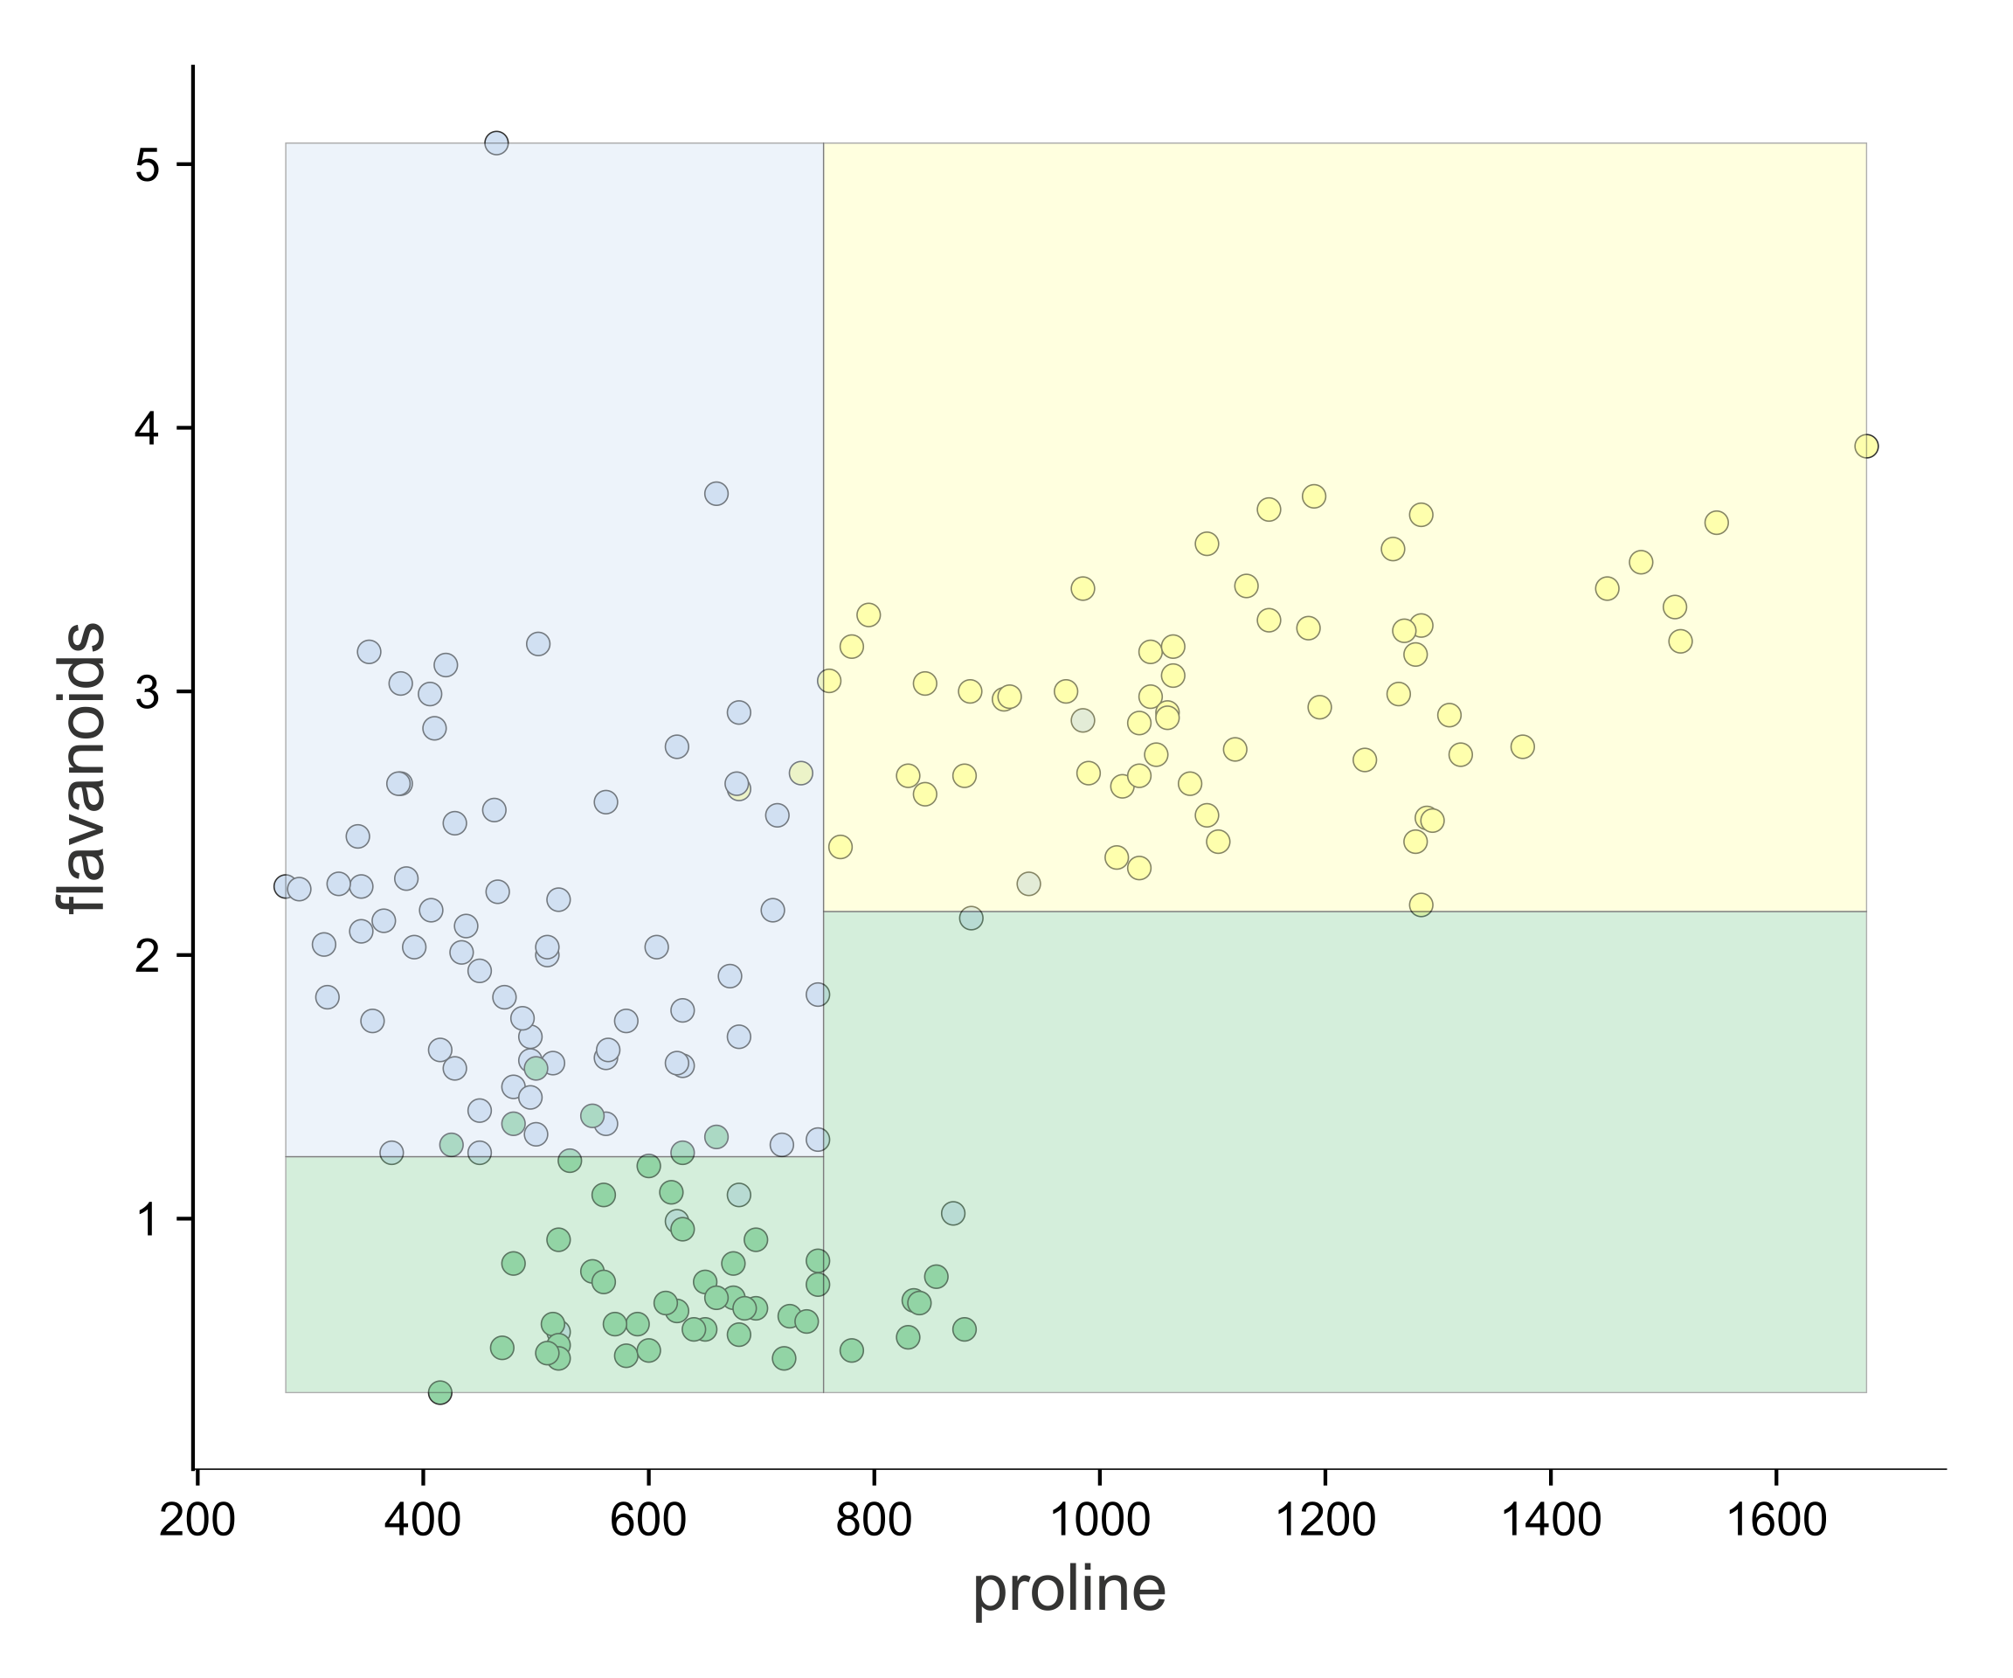
Improve predictions: Use 2 features and split 2D feature space into regions
x1
<
>=
y1
y2
y2
<
>=
<
>=
y1
Training looks for (feature, split point)
combo giving more pure subregions.
x1
Decision nodes compare single
feature value to split point

Slide 19
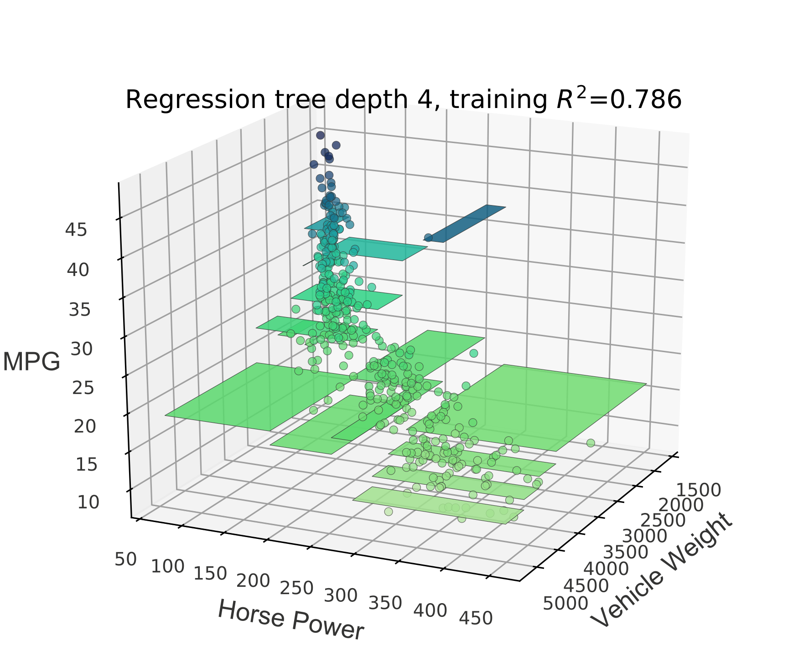
We can also split regressor 2D feature space into regions to improve accuracy
<launch awesome 3D visualization here>

Slide 20
Visualizing the key elements

Slide 21
1D feature space vs sklearn regressor tree

Slide 22
1D feature space vs dtreeviz decision tree

Slide 23
2D feature space vs sklearn classifier tree

Slide 24
2D feature space vs dtreeviz decision tree

Slide 25
Option: dtreeviz decision tree (strip plot nodes)

Slide 26
Test vector interpretation

Slide 27
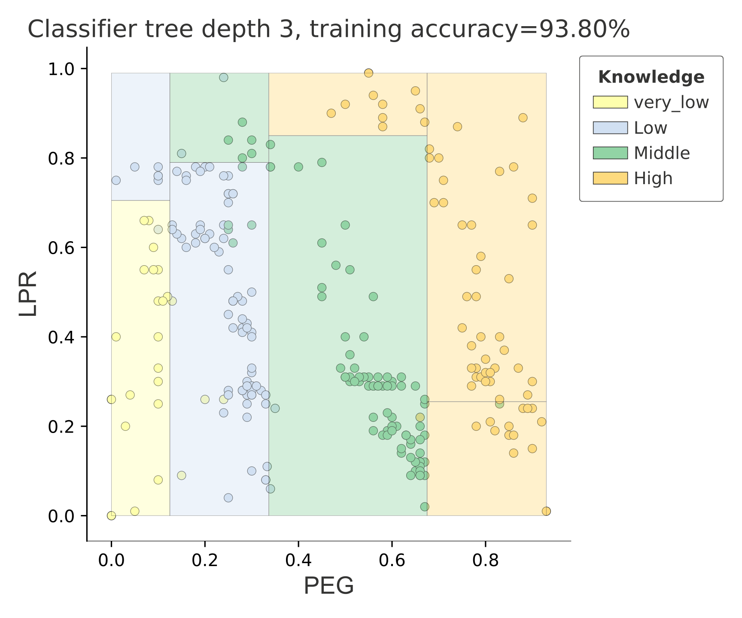
1D, 2D classifier feature space

Slide 28
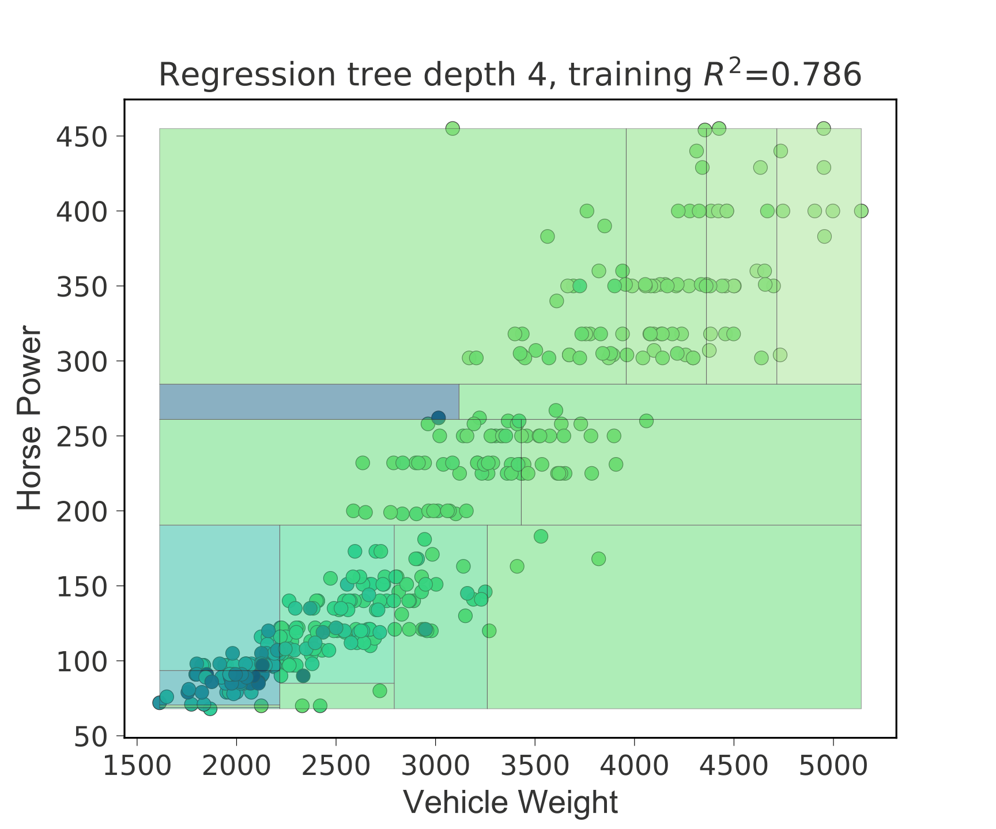
2D regressor feature space (heatmap, 3D)

Slide 29
Plain layout for large trees

Slide 30
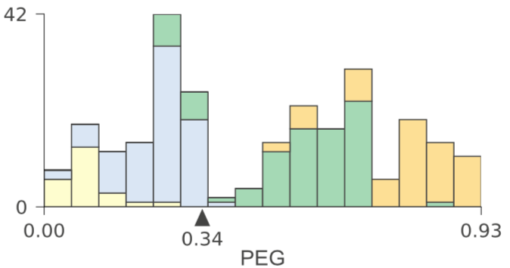
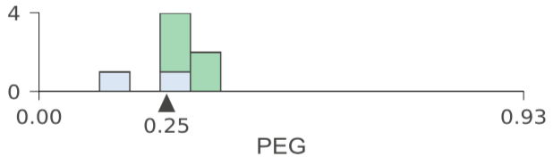
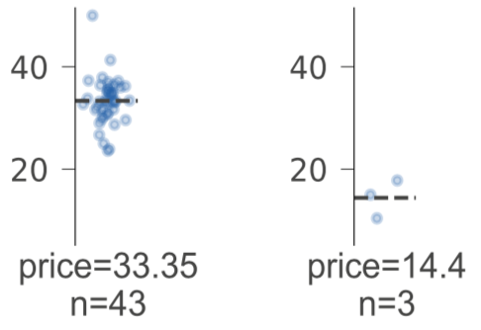
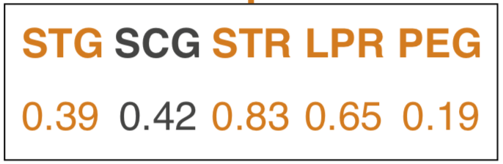
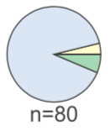
Details matter
Handpicked colors
Gray not black text/lines
Hairlines
Outlines of bars in barchart
Histos shrink
with sample size
Target axes show
same range
Highlight features
Used in test vector
Pie charts shrink
(nonlinearly)
with sample size

Slide 31
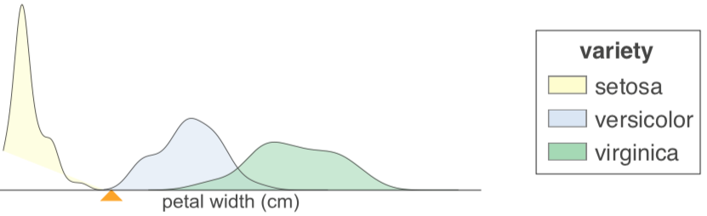
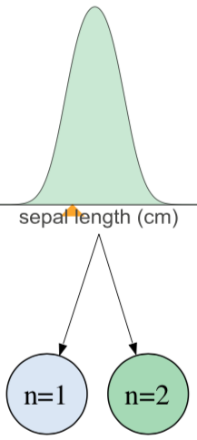
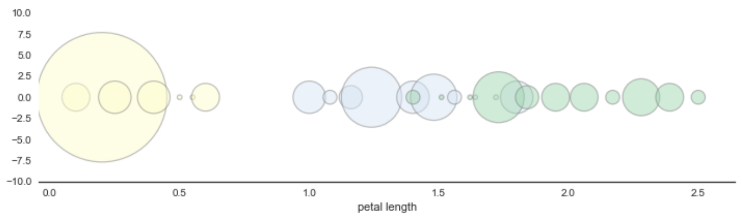
What we tried and rejected
Kernel density estimates (smooth histograms)
Bubble charts

Slide 32
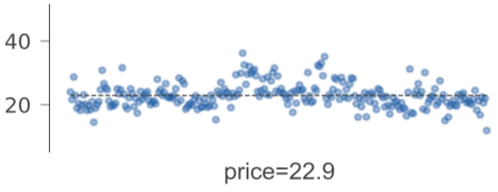
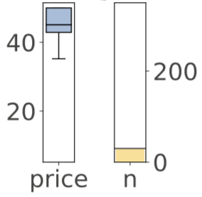
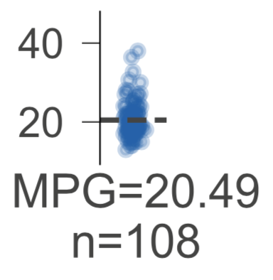
Tried various regression leaf types
Settled on strip plot

Slide 33
Implementation overview
We used matplotlib to generate images for decision, leaf nodes
Combined nodes into a tree using graphviz
Used HTML labels extensively in the graphviz for layout, fonts
Single biggest headache: convincing all to produce high-quality vector graphics (SVG)
Defined ShadowDecTree class to wrap sklearn trees

Slide 34
Generating high-quality graphics (SVG)
Want scalable graphics like PDF or SVG, not PNG, GIF, JPG
Import .svg or .pdf into graphviz? Nope.
Many hours later, discovered magic incantation for graphviz
Needed width/height of image; gotta parse SVG now
Graphviz generates SVG that references other SVGs
Wrote manual SVG image embedding tool to get single meta-SVG file
Uh oh. Graphviz doesn’t handle fonts correctly with SVG output
Generate PDF then run pdf2svg tool to convert PDF to SVG
Ah, but –Tsvg:cairo graphviz option does get fonts right
Switch code to straight SVG generation
Final insult: Jupyter notebook doesn’t show those SVG correctly

Slide 35
How to lead a fulfilling life by being dissatisfied

Slide 36
Be dissatisfied
Be offended by poor software and unsatisfying results
Crave beauty and quality
Quality must be baked in
Don’t put lipstick on a pig
Make the world a better place for others as you move along
Obsess about the details
Varying graph height, colors, box outlines, 3D plots, ...
Warning:
Dissatisfied personalities are annoying to those in the “blast radius”
Can send you off on tangents
But, your dissatisfaction is a win for everyone else

Slide 37
Be tenacious
Never let the computer win
Each loss would sap your confidence
Might require extraordinary lengths to solve
Lack of confidence leads to acceptance of status quo
“Why program by hand in five days, what you can spend five 30 years of your life automating?” -- parrt on ANTLR
Implementation of dtreeviz required pathological tenacity

Slide 38
Be courageous
Slap your code up on github, push to pypi, ship it!
Write articles or blog entries
Otherwise, you’re not helping the programming community
Building code and writing articles exposes holes in your understanding; holes become chasms as you try to explain
Face that fear; can’t improve unless you identify weaknesses
Students: these artifacts get you the job
You might think you don’t know anything (true at beginning)
Start with simple libraries or blogs, then stretch/reach
Practice expanding your abilities

Slide 39
Be a finisher
Constant tension between perfectionism and finishing projects
Details matter but must still ship it
Go off on tangents to solve subproblems but always return to finish the original problem
Make completion a key personality parameter to optimize
I know researchers with only unpolished, unpublished projects
How do you want to be measured?

Slide 40
How to contribute and make a difference
Look for the pain
Look for a hole in the market
Erase the pain with reusable and general code
Learn tactics from existing successful projects:
good name
website with domain devoted to project
useful doc
API design is hard; think hard about it
focus on conceptual integrity, consistent style
use social media to your advantage

Slide 41
“The reasonable [wo]man adapts [her|him]self to the world: the unreasonable one persists in trying to adapt the world to [her|him]self. Therefore all progress depends on the unreasonable [wo]man.”
― George Bernard Shaw

Slide 42
Resources
Decision tree visualization article: https://explained.ai/decision-tree-viz/index.html
My website for deep explanations of AI-related stuff: https://explained.ai
fast.ai's Introduction to Machine Learning for Coders MOOC: https://course.fast.ai/ml
U of San Francisco’s MS Data Science program: https://www.usfca.edu/arts-sciences/graduate-programs/data-science
https://matplotlib.org/
http://graphviz.org/

